Slide 1


Analytics
A Project on in-depth analysis, visualization and Machine Learning on the Yelp Dataset

Slide 2
Presented by Charudatta Marne, Jyoti Chaudhary, Paritosh Sangave, Saumyajit Guha and Sourabh Jamdade
Guided by
Dr. Krishnanjan B.

Slide 3
GOALS
Set up data pipelines to store and process the data
Warehouse the Yelp dataset for processing and analysis.
Analysis and extraction of information from data to make pertinent visualizations to draw business insights.
In depth analysis of individual cuisines among all the restaurants.
Building and deploying Machine Learning models namely Recommender system and Sentiment analysis.
Creating dashboards and User Interface using Streamlit. Deploy above mentioned ML models using Streamlit.

Slide 4
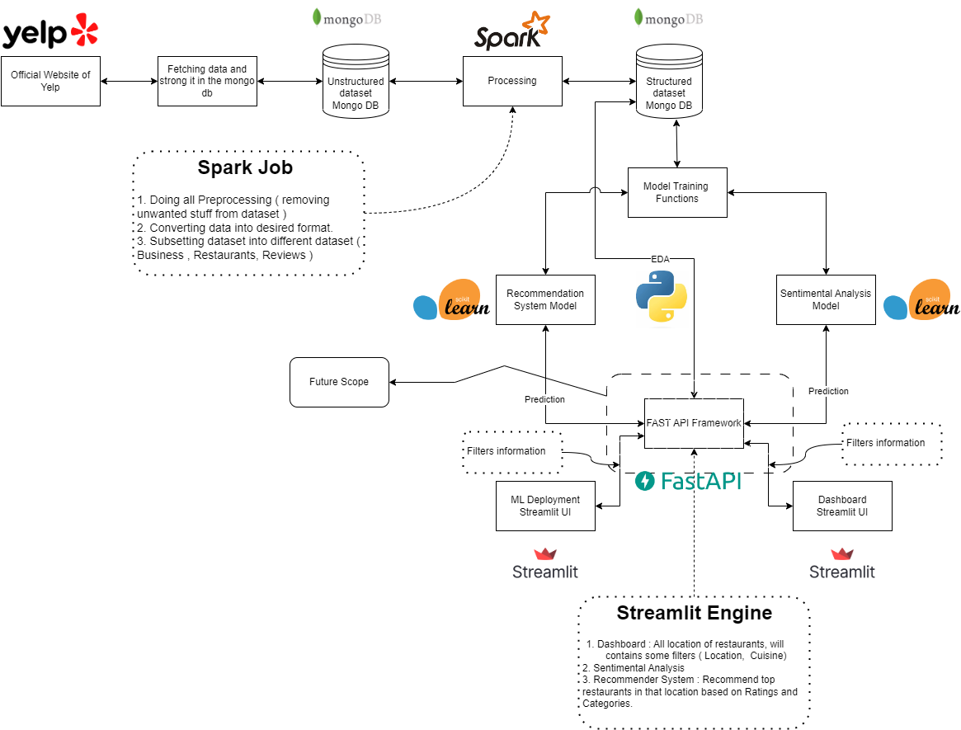
SYSTEM ARCHITECTURE
DIAGRAM

Slide 5
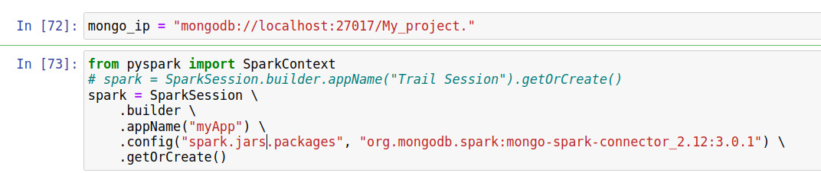
DATA ENGINEERING
Majorly Comprises of following Stages:
Stage1:
Loading the data into MongoDB .
Building the pipeline between MongoDB and Spark(Code excerpt in below image).
Warehousing, pre processing and extracting the data in Spark.
Splitting data into chunks required for different use-cases and export it back into MongoDB

Slide 6
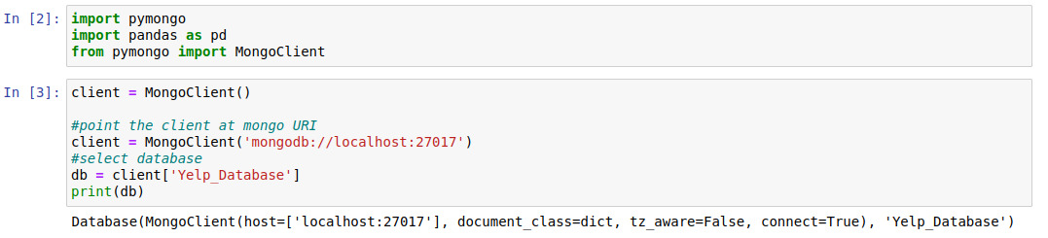
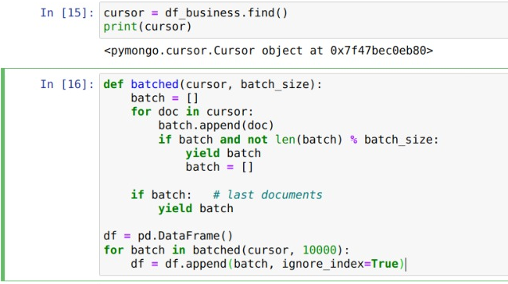
DATA ENGINEERING
Stage 2:
Building the pipeline between processed data in MongoDB and PANDAS(Code shown in below image).
To build Pipeline between MongoDB and PANDAS we used PyMongo.
Using Python(Pandas , Seaborn, Matplotlib) we created various visualisation which shows some business insights

Slide 7
DATA DESCRITION
We have a yelp dataset of 9 GB size having following Json files :-
1)Business(rows-152k) - Contains business data including location of data, attributes, and categories.
2)Review.json(rows-7M)-Contains full review text data including the user_id that wrote the review and the business_id the review is written for.
3) User.json: User data including the user's friend mapping and all the metadata associated with the user.
4) checkin.json : Check-ins on a business.
5) tip.json : Tips written by a user on a business. Tips are shorter than reviews and tend to convey quick suggestions.
From these two datasets we have used Business and Review datasets for our further analysis.

Slide 8
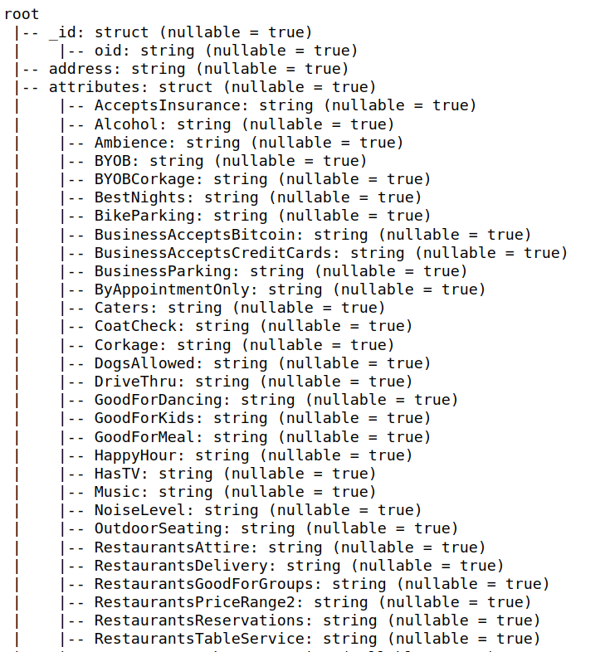
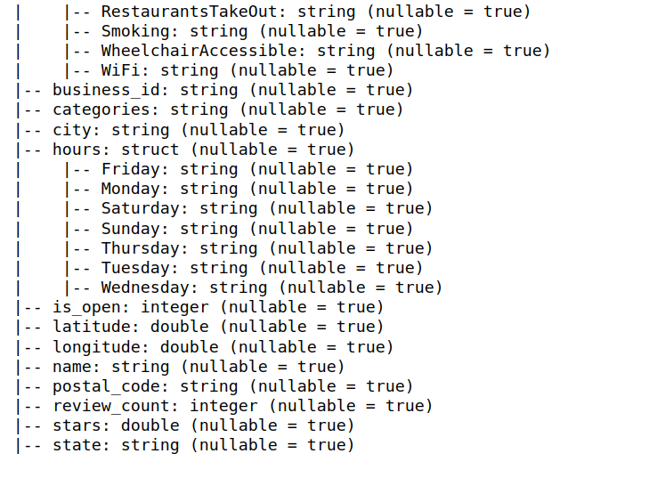
Da Business Dataset Schema

Slide 9
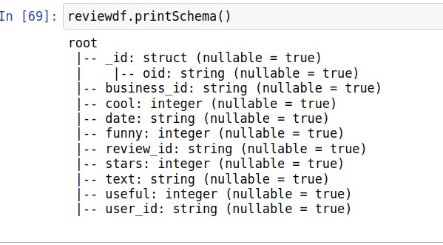
Review Dataset Schema
Contains full review text data including the user_id that wrote the review and the business_id the review is written for.

Slide 10
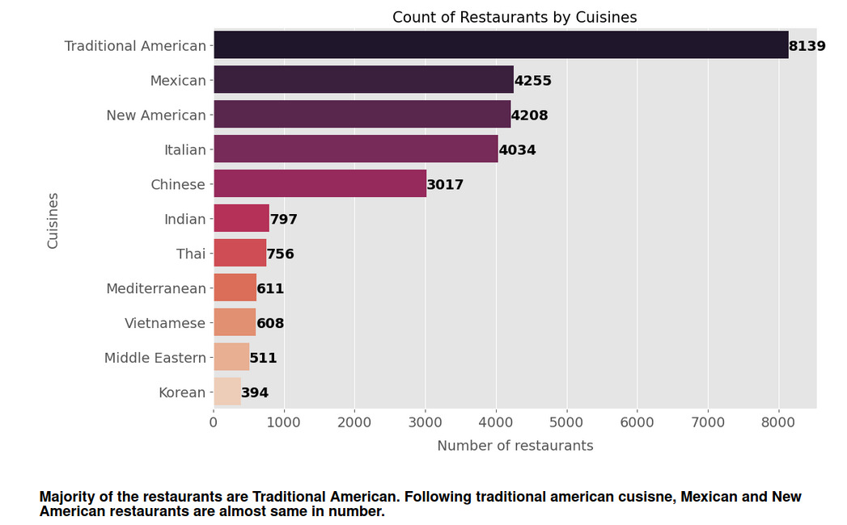
ANALYSIS AND VISUALISATIONS
A] Restaurants Analysis with 11 selected cuisines.

Slide 11
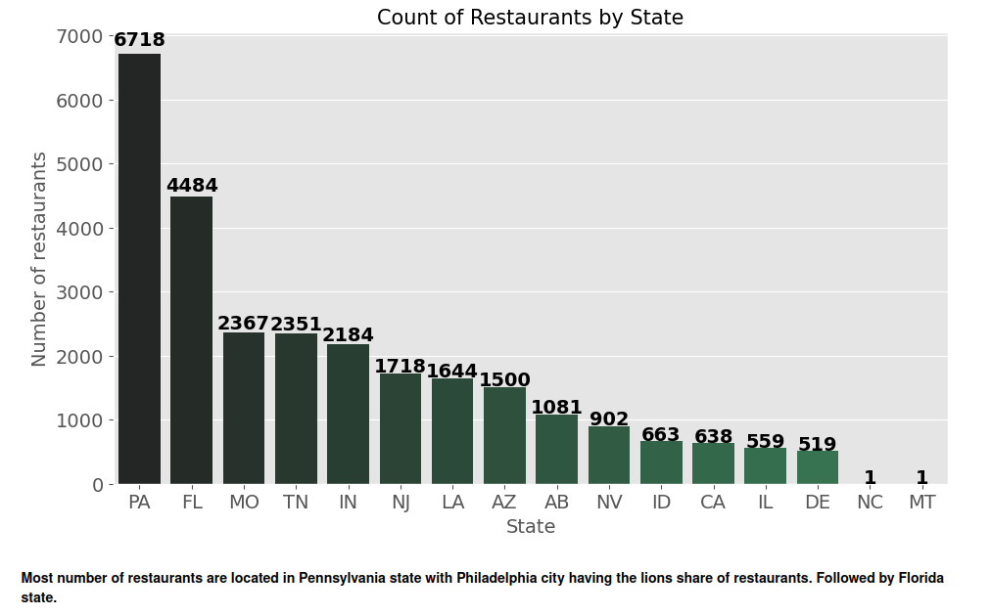

Slide 12
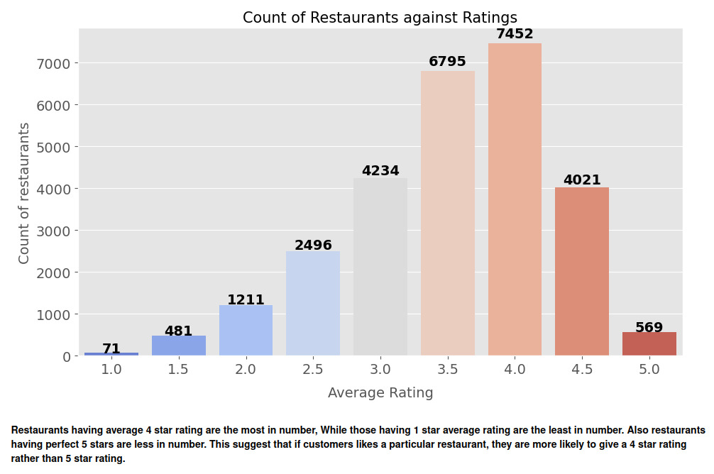
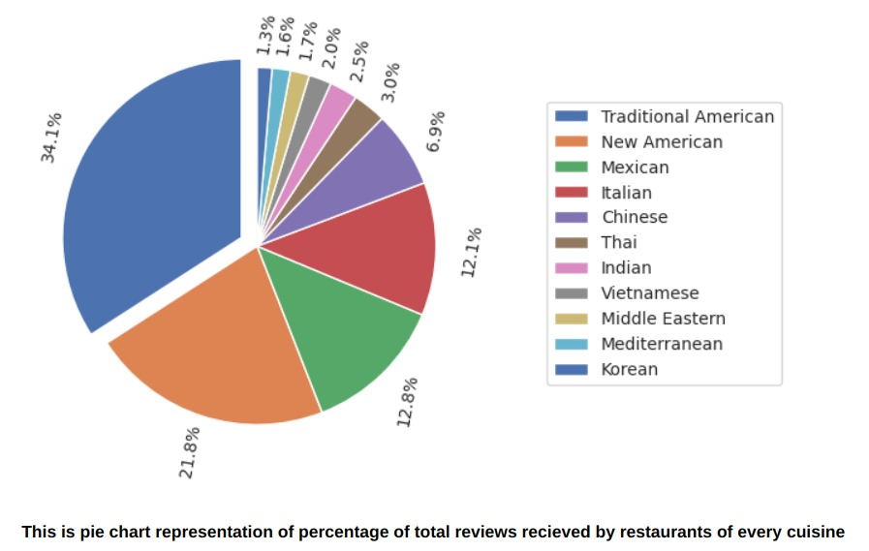

Slide 13
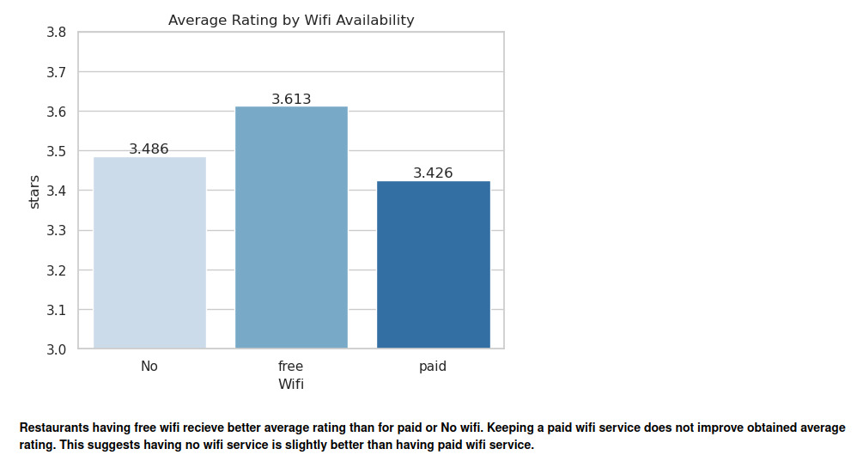

Slide 14
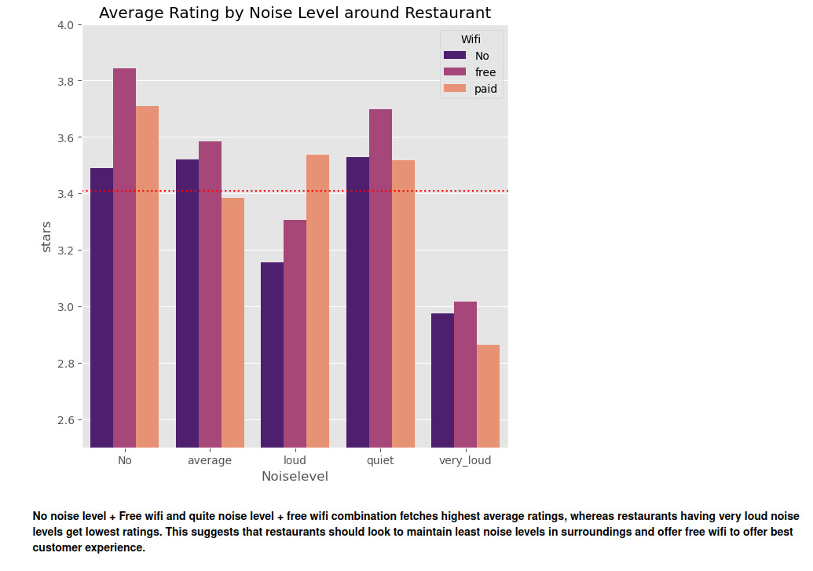

Slide 15
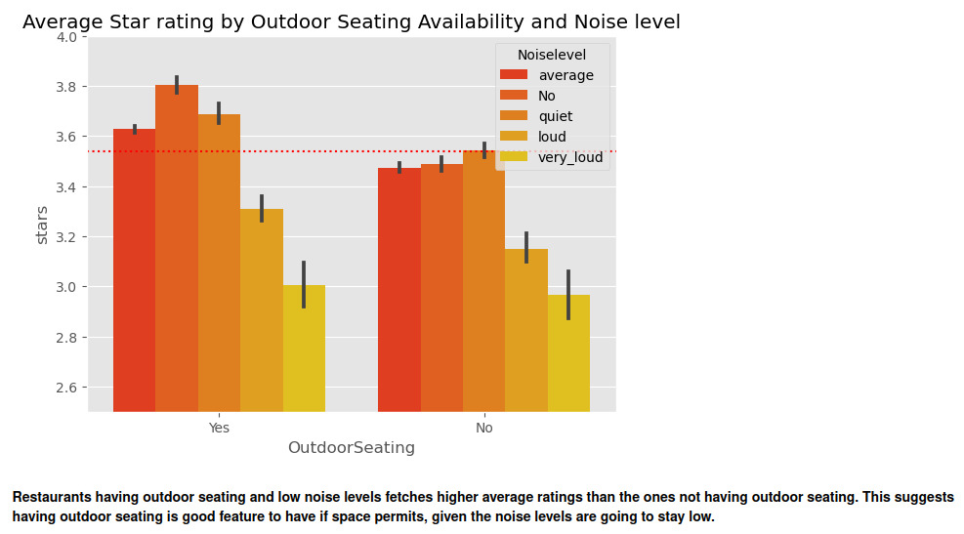

Slide 16
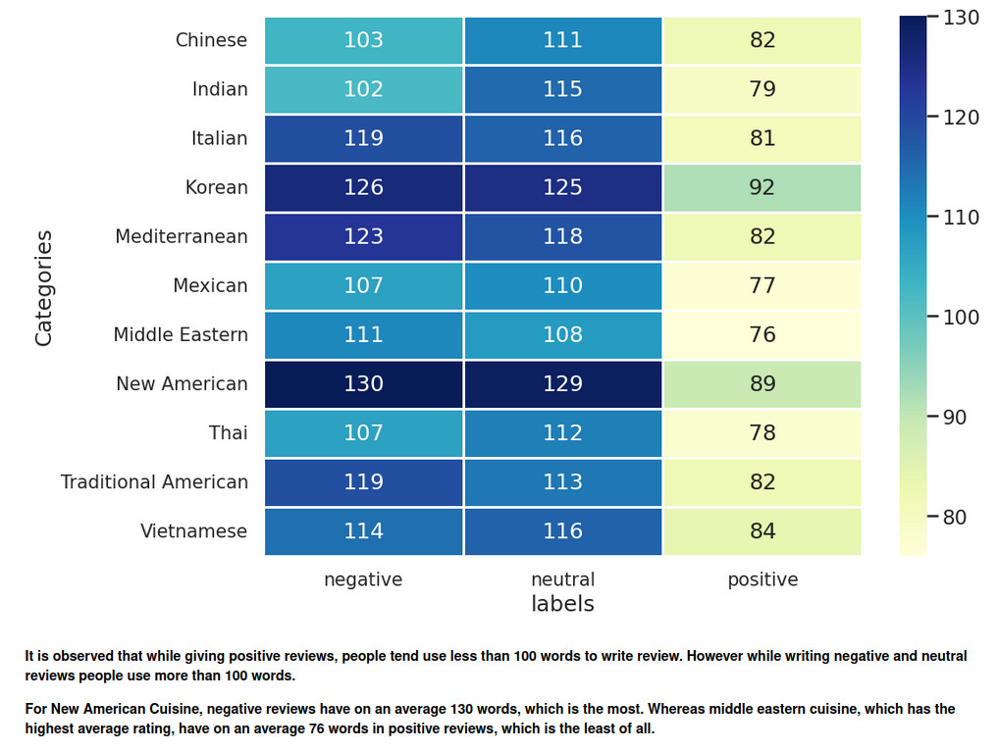
B. Restaurants Review Analysis for Florida State

Slide 17
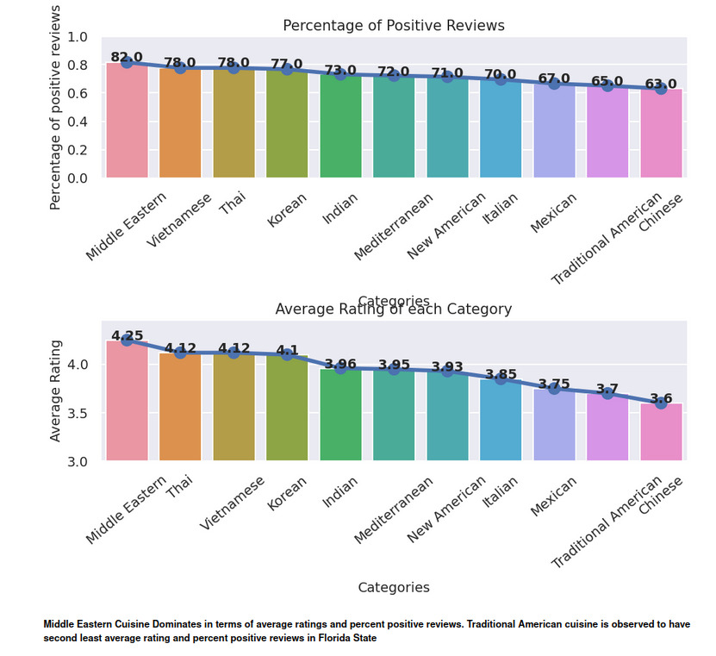

Slide 18
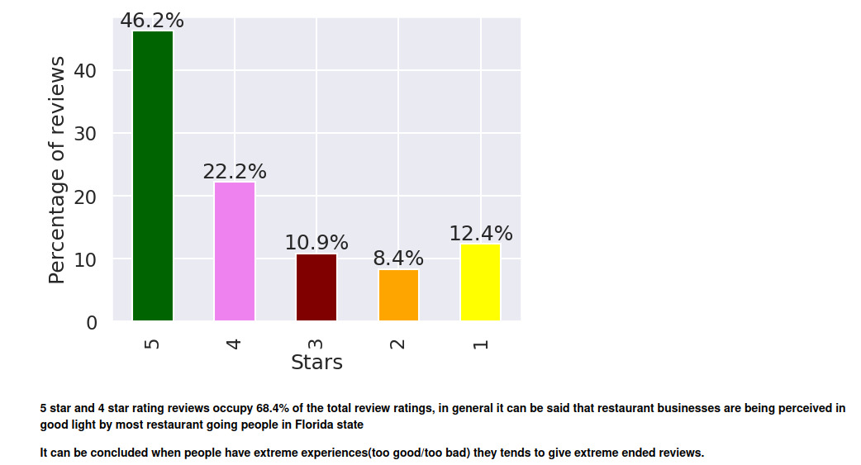
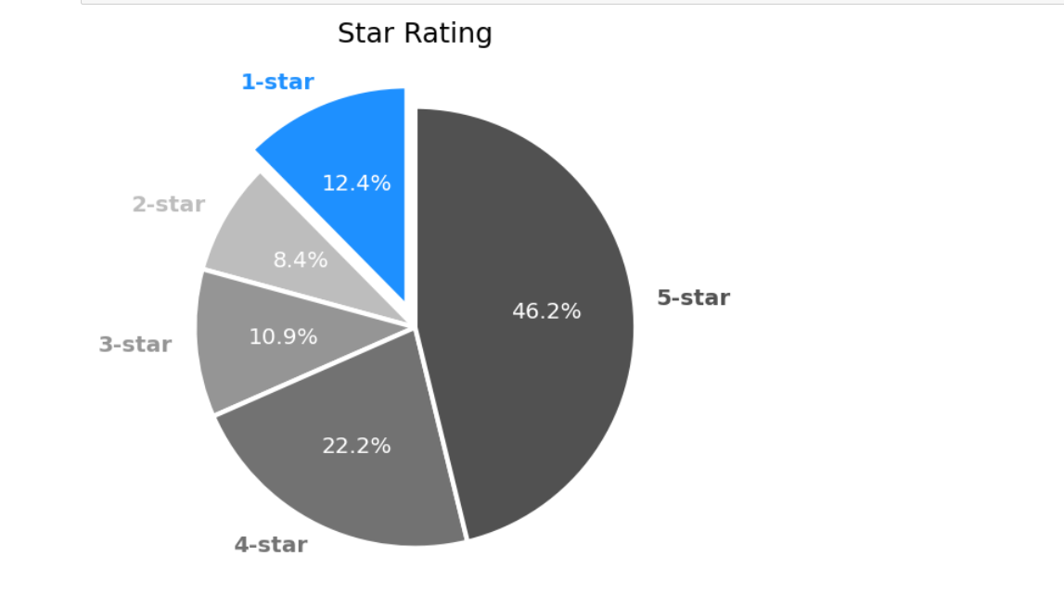
Percentage Distribution of stars Rating of restaurants in Florida State

Slide 19
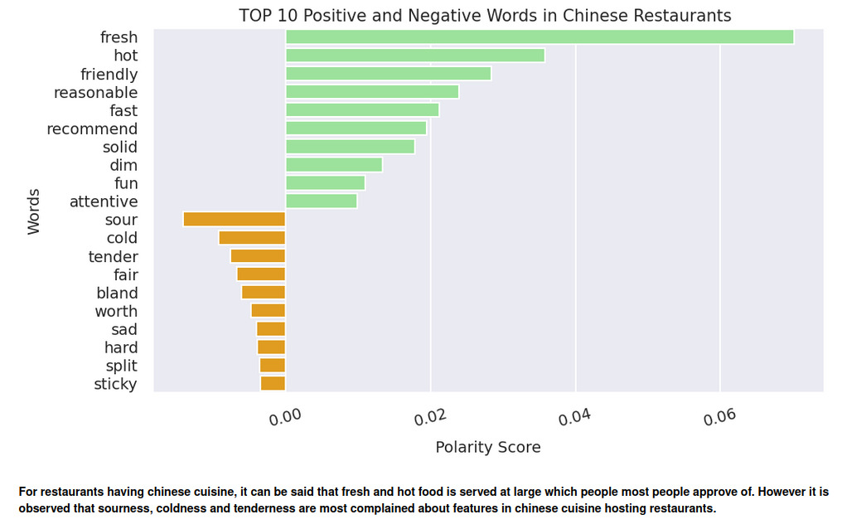

Slide 20
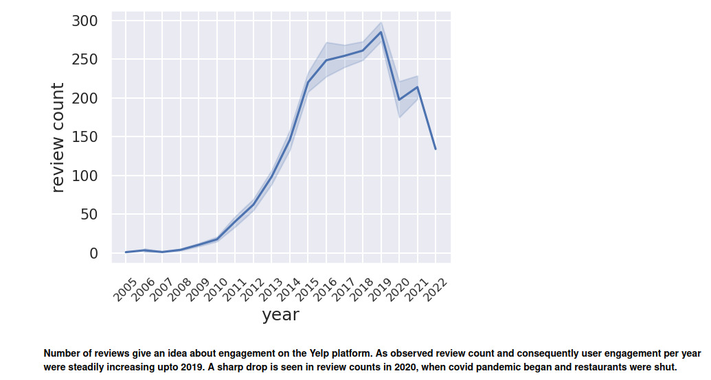
Variation In Review Count By Year For Chinese Cuisine

Slide 21
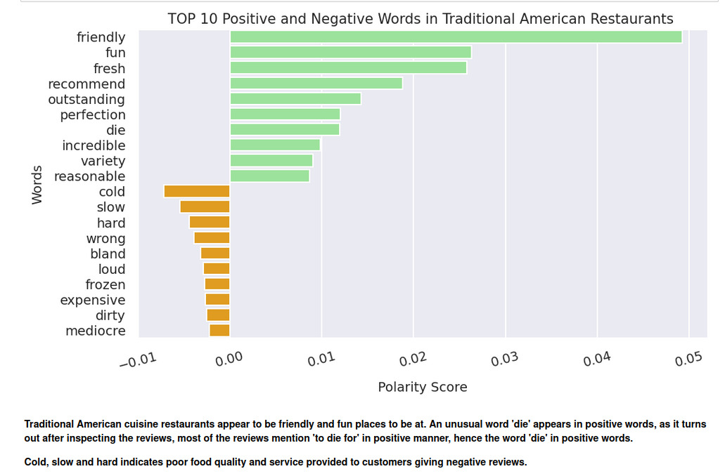

Slide 22
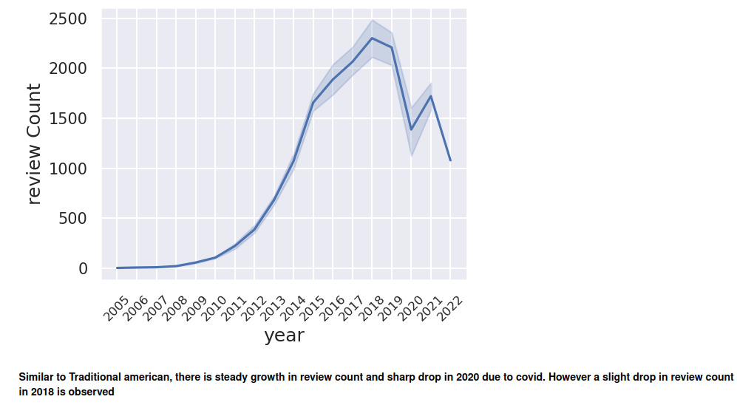
Variation In Review Count By Year For Traditional American Cuisine
which we speculate is due to the traditional American restaurants losing popularity in face of new trendy alternative cuisines.

Slide 23
Machine Learning Algorithms
Sentiment Analysis
Recommender System
SENTIMENT ANALYSIS :
Sentiment analysis, also referred to as opinion mining, is an approach to natural language processing (NLP) that identifies the emotional tone behind a body of text. This is a popular way for organizations to determine and categorize opinions about a product, service or idea.
Yelp is widely used for review and rating. User reviews can bring insight for restaurant owners for service improvement, and help potential customers find their choice of dining.
Therefore, the objective of this sentiment analysis model is to identify the polarity (positive or negative) of Yelp restaurant reviews, and extract keywords that contribute to the positive or negative reviews. The project focuses on enhancing customers’ understanding of restaurants, educating new restaurant owners on market knowledge, and improving existing owner’s awareness about their restaurant performance.

Slide 24
Sentiment Analysis
Steps Involved :
Gathered yelp reviews for Florida state(443834 rows).
Pre-processed and cleaned reviews using NLTK libraries (expanding, removing stopwords [except ones that express sentiment], tokenization, lemmatization, contraction etc)
Classifying the different reviews as per the STAR RATING .
Greater than or equal to 3.5 => Positive Review
Greater than or equal to 2.5 => Negative Review
Created a word cloud for each sentiment ( positive + negative).
Used TFIDF Vectorizer for finding the relevance of each terms/word in the document.
Random Sampling of 100k rows for training the model 10k more random samples from reviews dataset for testing the model
Tested the Sentiment Analysis model
Analysed yelp(Florida-restaurants) reviews.
Tried Different Models and Strategies : XGBOOST , LightGBM , Random Forest , Naïve Based, Logistic Regression
BEST MODEL : XGBOOST

Slide 25
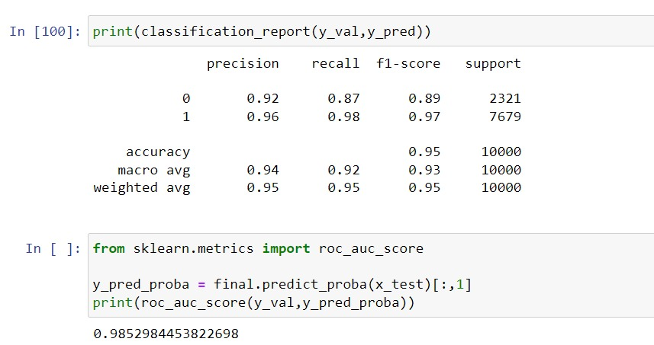
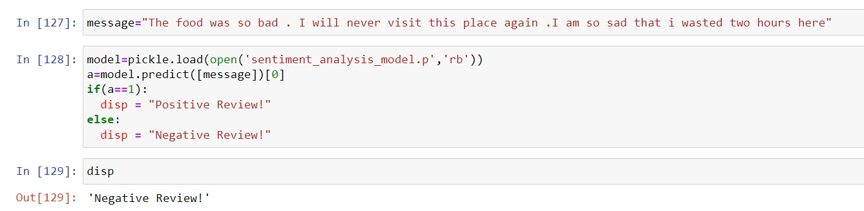
Sentiment Analysis: Score and Test Result

Slide 26
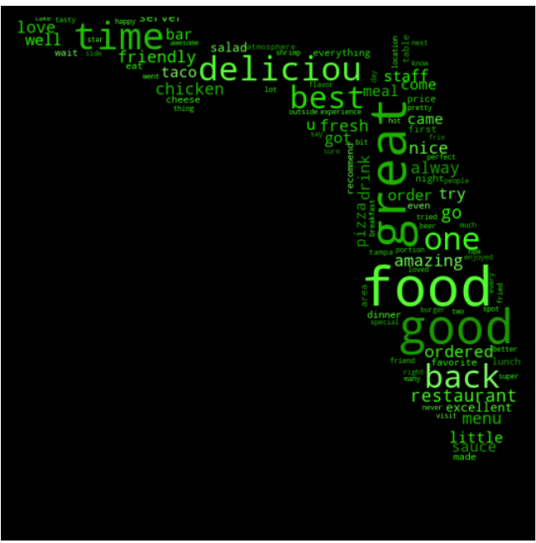
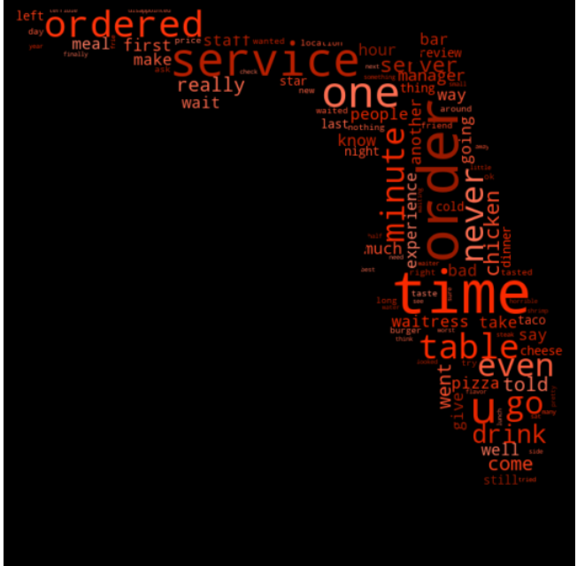
SENTIMENT ANALYSIS (WORD CLOUD)
POSITIVE WORDS
NEGATIVE WORDS

Slide 27
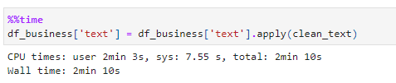
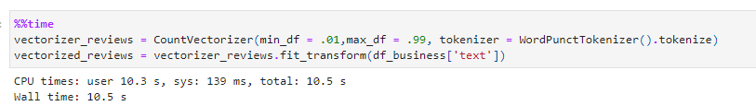
Recommender System
For the recommender system we have gone with a simpler approach where we use the categories and the reviews provided for the restaurant to build a sort of Content Based Filtering model to provide the user recommendations for other similar restaurants.
We process the “review” text to remove and filter out any sort of garbage or unwanted characters.
We then use sklearn CountVectorizer to create a Bag of Words for both the reviews and the categories

Slide 28
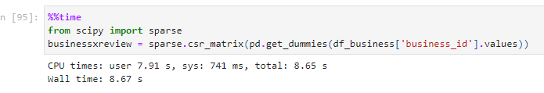
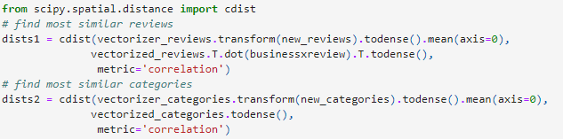
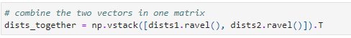
We create a sparse matrix of business_ids of all reviews vs unique business_ids by dummying it using get_dummies to get a numerical representation of the business_ids
Select a restaurant and calculate the correlation distances of the categories and reviews of that restaurant vs all of the others.
Combine the vectors vertically and find the mean, the arguments of which when sorted should give us the closest matches

Slide 29
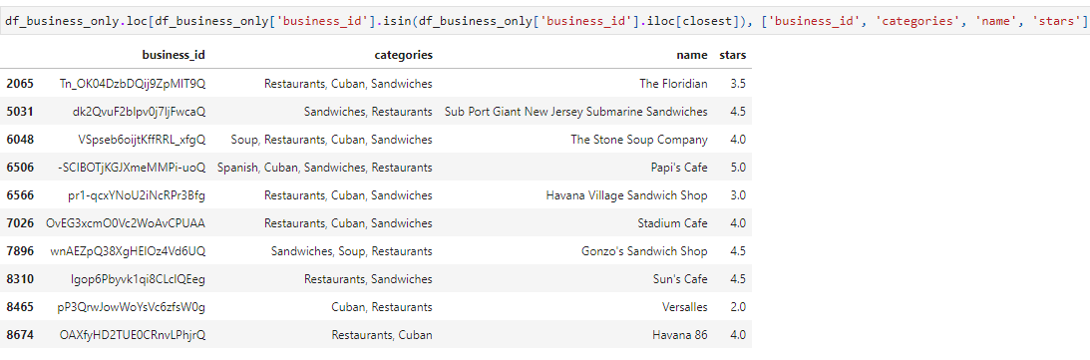
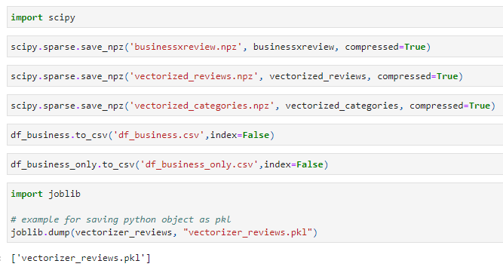
Now locate them in the original data frame! And we have 10 recommendations!!
Lets save the data for deployment!

Slide 30
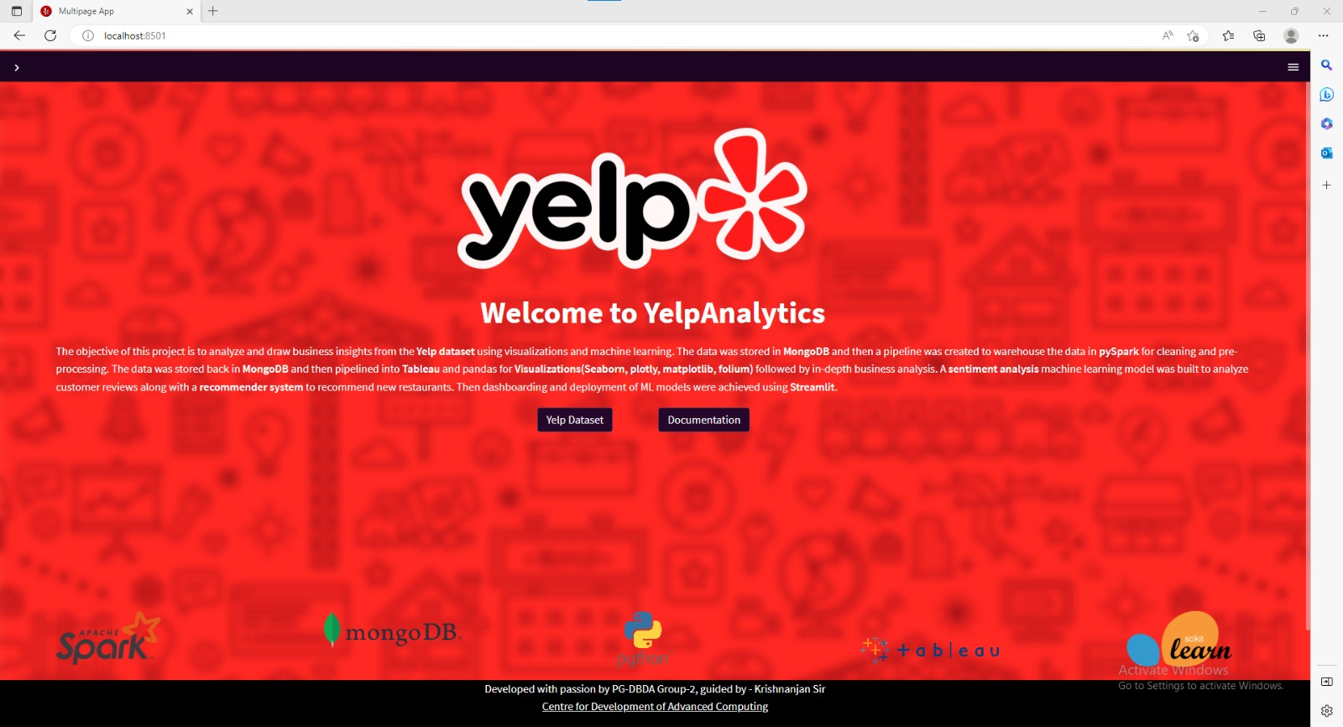
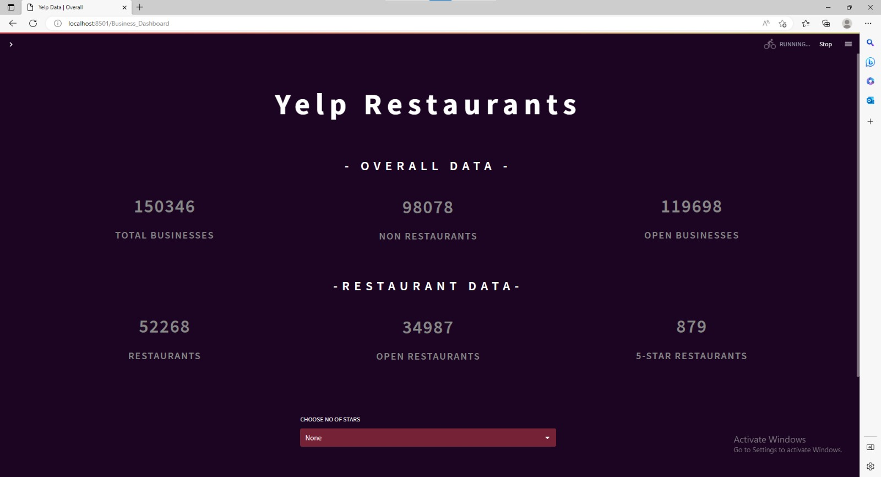
Deployment
Popular open-source app framework for Machine Learning and Data Science Streamlit has been used for dashboarding and for deployment of Machine Learning Models.
UI Examples:

Slide 31
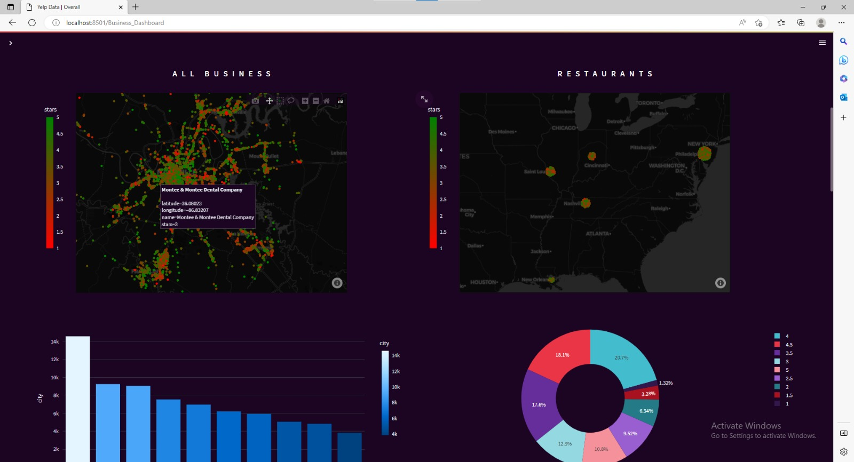
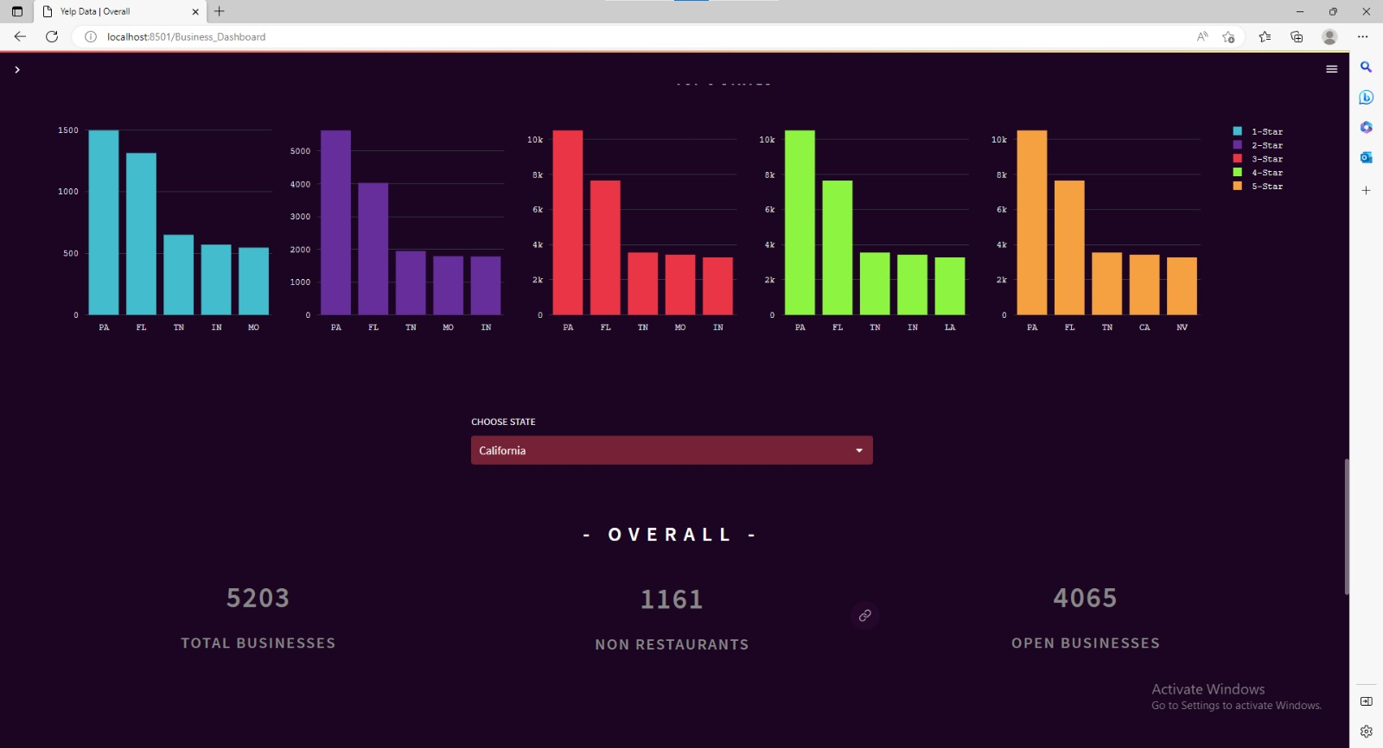
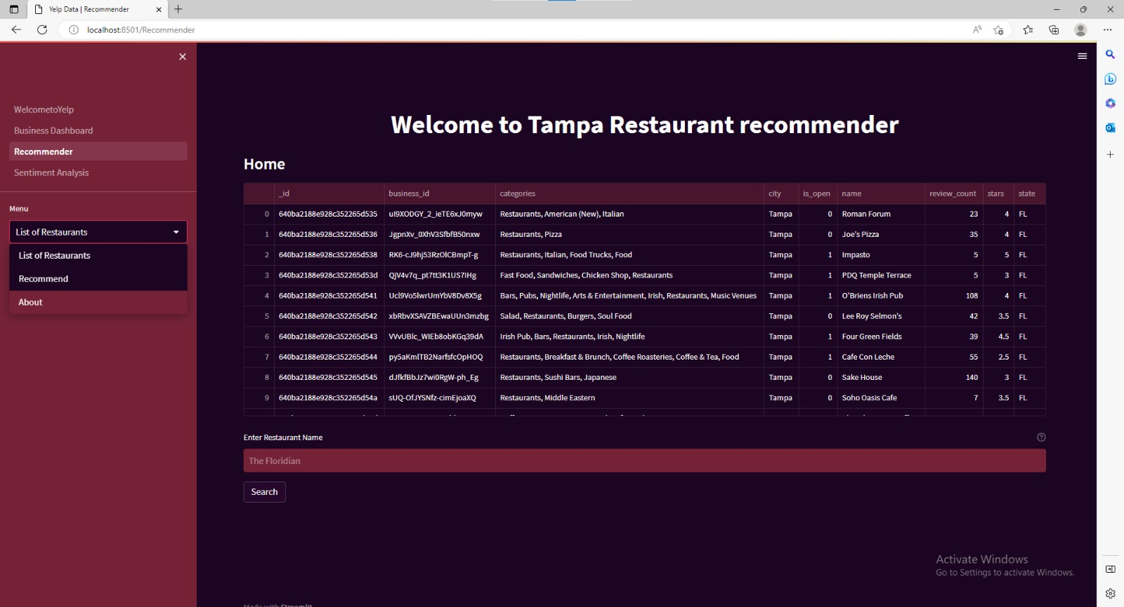
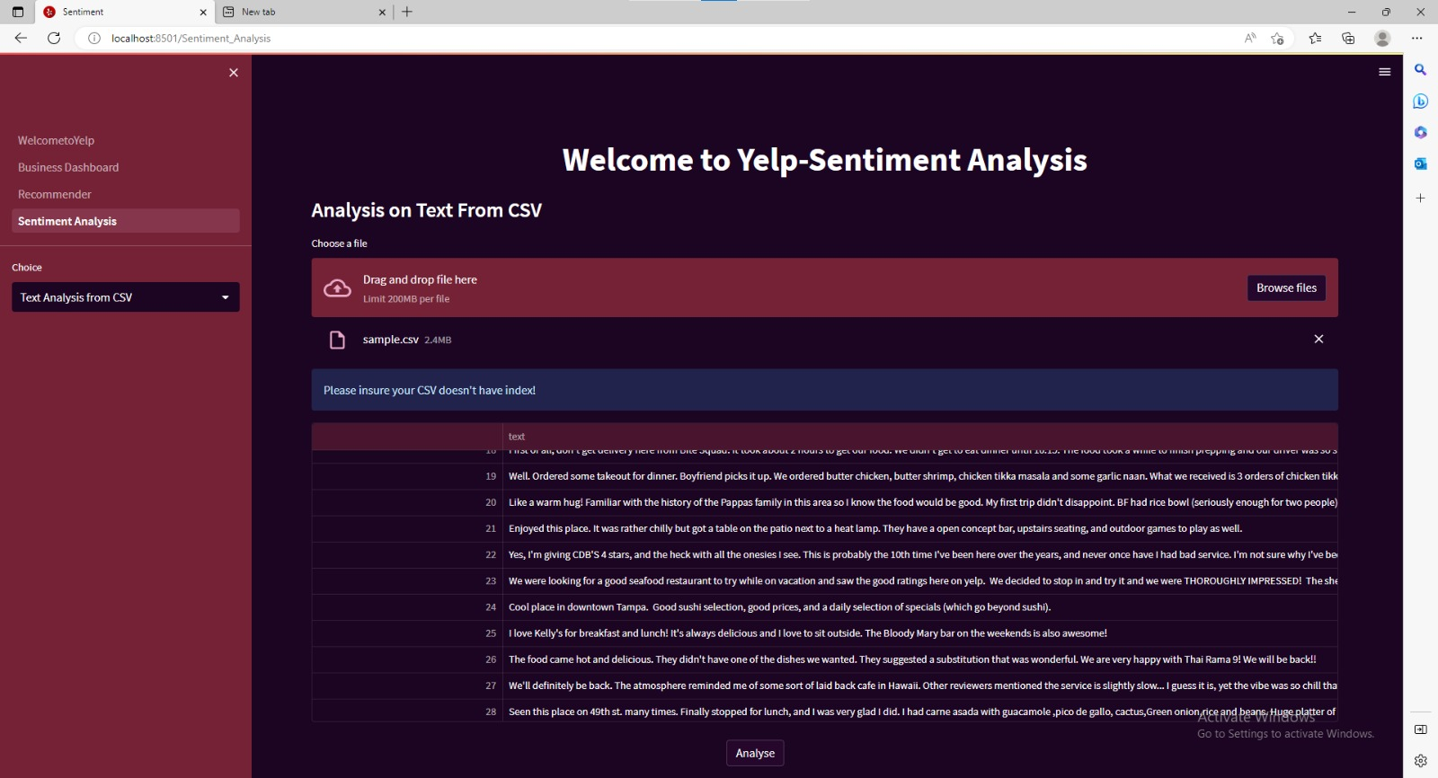

Slide 32
Challenges Faced
There were little to no knowledge on how to connect Mongo to Spark
Due to huge data size we had to narrow down our analysis towards specific attributes ,selected cuisines and Florida state.
Computational speed due to less ram and processing power.
Due to huge dataset we had to use Batching to load data from Mongo database.
Recurring OutOfMemory error in Spark due to limited availability of RAM.
Initially an attempt was made to build model on entire dataset of Florida, also balancing of positive and negative reviews which resulted in longer runtimes and poor accuracy scores for models.
The initial models were built using the whole review body as corpus which meant that we could only deploy the model with another large data frame. So we had to start from scratch.
The sparse matrix for recommender system on 700k reviews was not possible since the kernel would crash. Eventually we had to subset the reviews to a certain city.

Slide 33
Future Scope:
Working on and analysing other dataset like user , tip dataset etc.
2. Improvising the machine learning models.
Developing a backend API
Deployment of model on Cloud.
ki9ng of

Slide 34
THANK YOU

